Slide 1
Mushroom Classification
Team 10 Project
Isabelle Hatch, Brendan Gosa, Andrew Kim and Natalie Fernandez

Slide 2
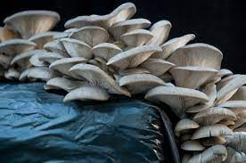
Content
Question
Motivation
Mushroom Classification Dataset
General information
Goals With Dataset
Introduction to Attributes
Data and Models
Data and Statistics
Correlation Metrics
K-NN Model
Decision Tree Model
Naïve Bayes Model
Results and Analysis

Slide 3
Question
Would you be able to look at a mushroom and know whether it was safe to eat or not?

Slide 4
Motivation
Foraging mushrooms has been around for thousands of years and is becoming more popular in the United States (Viator, 2023)
There are thousands of different species of mushrooms in the world and many more that have yet to be discovered
Approximately 100 species of mushrooms cause many mushroom related poisonings amongst humans and 15-20 different species are lethal if eaten (Medscape, 2023)
Our goal is to identify which characteristics of gilled mushrooms in North America can be used to identify whether the mushroom is safe to be consumed

Slide 5
Overview of the Data
This data was originally contributed to the University of California Irving Machine Learning repository from almost three decades ago.
This dataset was donated in 1987
The dataset includes hypothetical descriptions of 23 different species of gilled mushrooms from the Agaricus and Lepiota Family
These descriptions were made from the The Audubon Society Field Guide to North American Mushrooms which was a guide to mushrooms created in 1981
This guide was created by a number of scientists, scholars, experts in this field, photographers and designers to create this highly trusted guide with over 2,900 photos of over 600 mushrooms that can be found in North America (Audubon)

Slide 6
Our Goals With The Data
To be able to use machine learning methods to best determine based on at the attributes of the mushroom whether the mushroom is edible or poisonous
To figure out which machine learning method get the most accurate results for this dataset

Slide 7
Introduction to Attributes
The Target Variable of this dataset is “Class” which is a binomial variable (either ‘p’ for poisonous or ‘e’ for edible)
There are 22 important attributes that affect the target variable (poisonous)
The attributes are all categorical and are binomial or polynomial

Slide 8
Attributes
Cap-Shape: the shape of the top of the mushroom
Cap-Surface: the texture of the top of the mushroom
Cap-Color: the color of the top of the mushroom
Bruises: whether the mushroom has bruises
Odor: the smell the mushroom gives off
Gill Attachment: the way the gills are attached to the cap of the mushroom
Gill Spacing: how far the gills are from each other
Gill Size: whether the gills are broad or narrow
Gill Color: the color of the gills
Stalk Shape: whether the stalk of the mushroom is enlarged or tapering
Stalk Root: the shape of the root of the mushroom
Stalk Surface Above Ring: the texture of the surface of the stalk above the annulus
Stalk Surface Below Ring: the texture of the surface of the stalk below the annulus
Stalk Color Above Ring: the color of the stalk above the annulus
Stalk Color Below Ring: the color of the stalk below the annulus
Color of the Veil: the color of the veil of the mushroom
Ring Number: whether there are 0,1 or 2 rings
Ring Type: the type of ring (if exists) that a mushroom has
Spore Color: the color of spores a mushroom has
Population: how multiple mushrooms of the same species are discovered
Habitat: what the area the mushrooms were found in is like
We removed the attribute Veil Type because it was consistent across all of the gilled mushroom species in this dataset

Slide 9
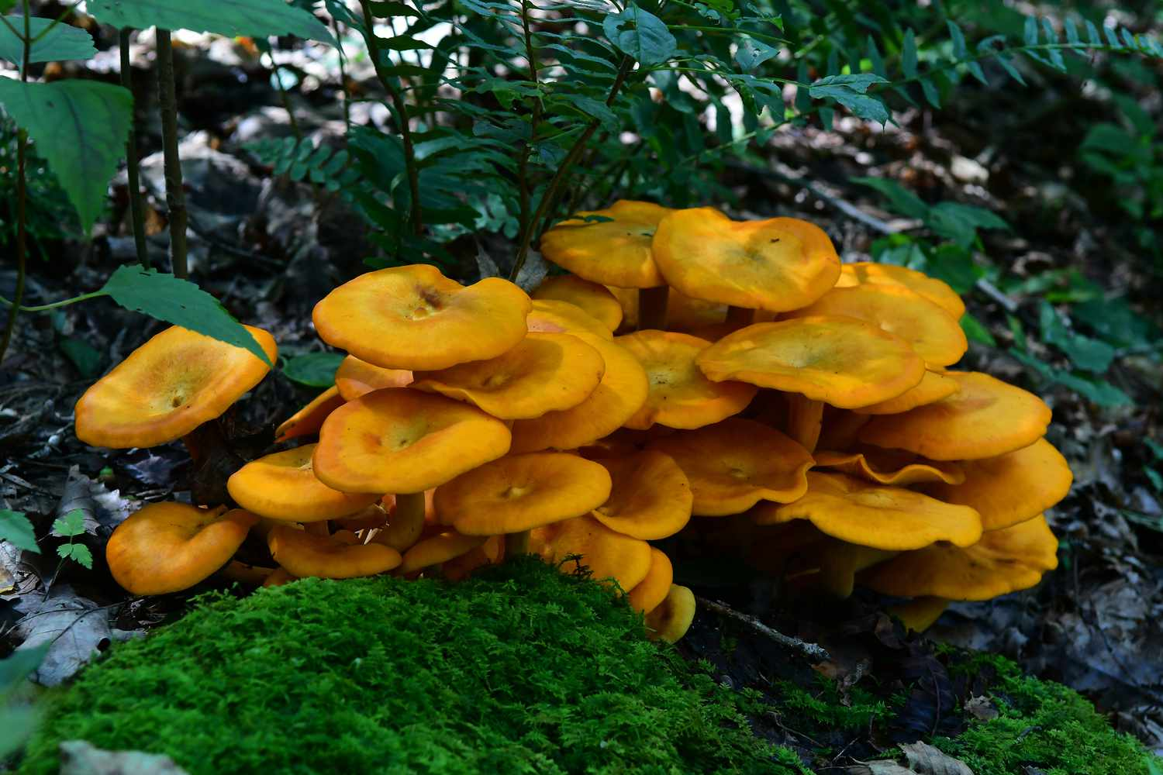
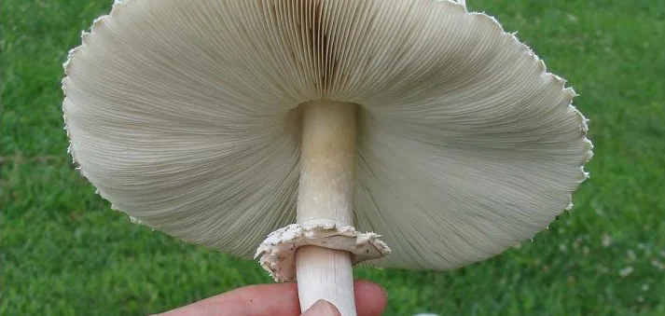
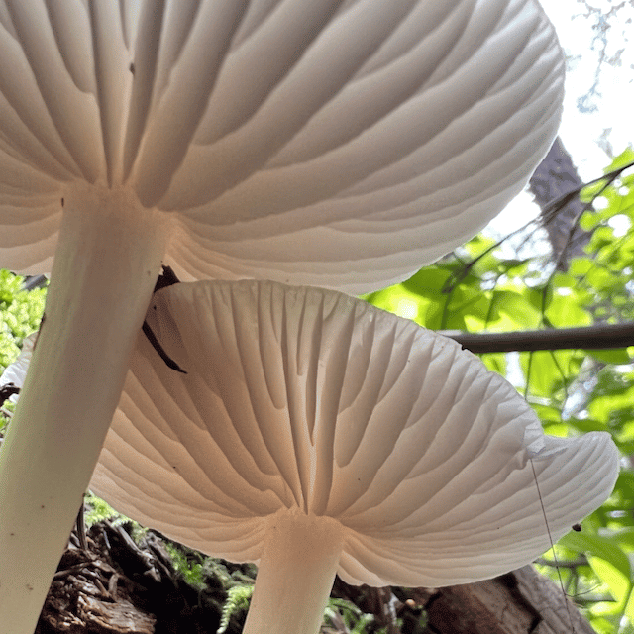

Slide 10
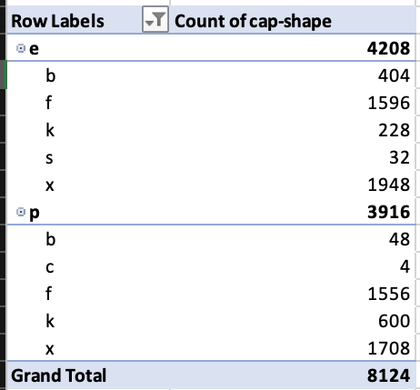
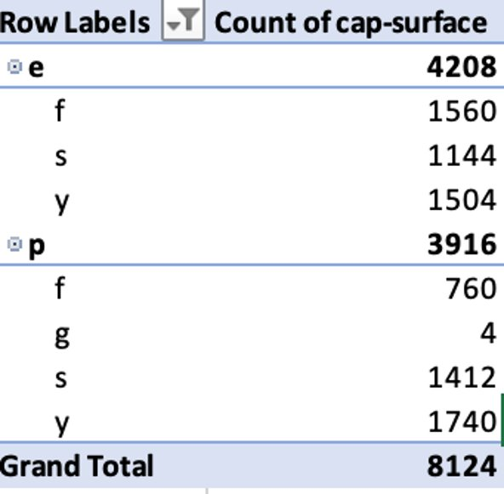
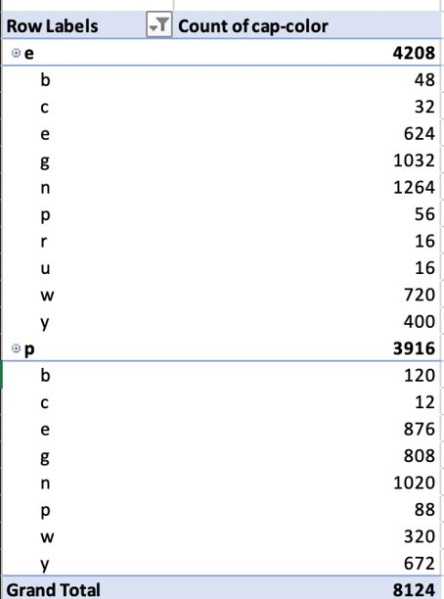
Cap shape, Surface, and Color

Slide 11
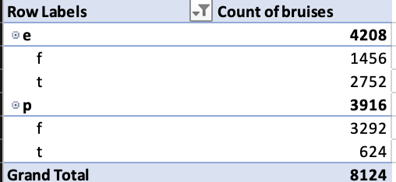
bruises

Slide 12
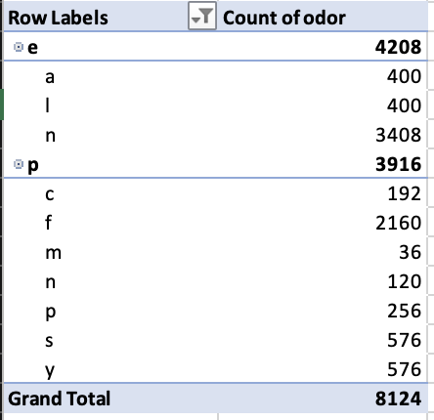
odor

Slide 13
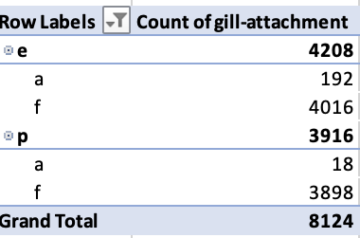
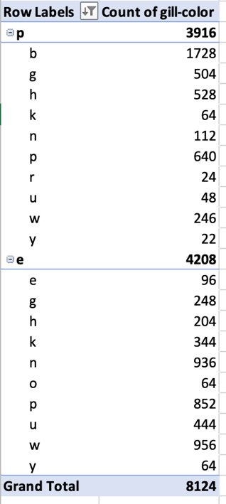
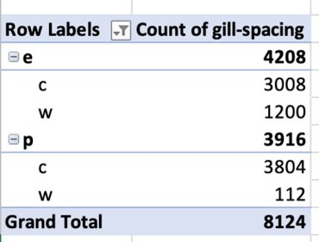
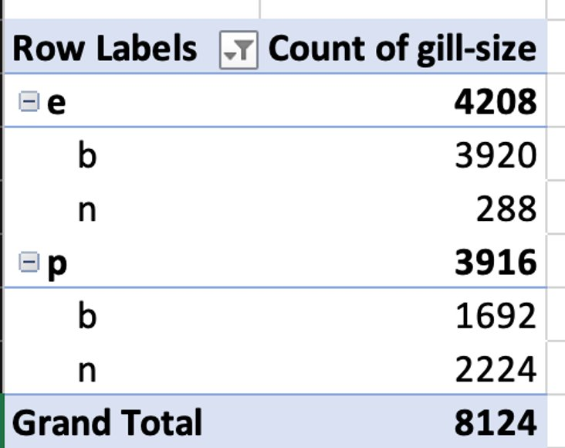
Gill attachment, Spacing, Size, and Color

Slide 14
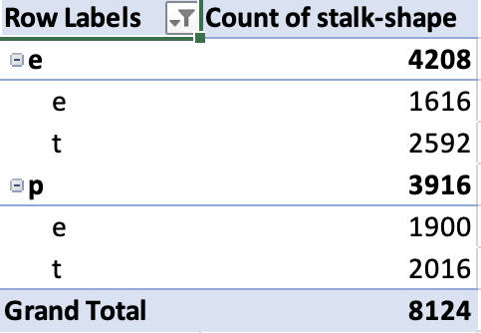
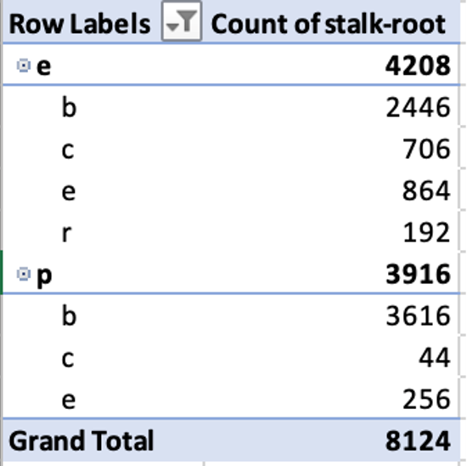
Stalk shape and Root

Slide 15
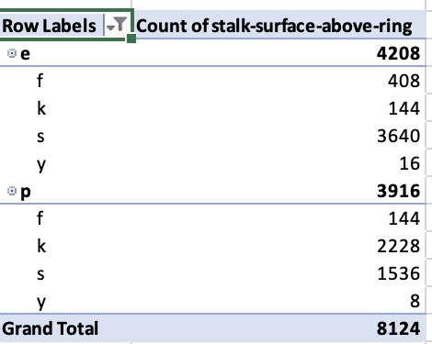
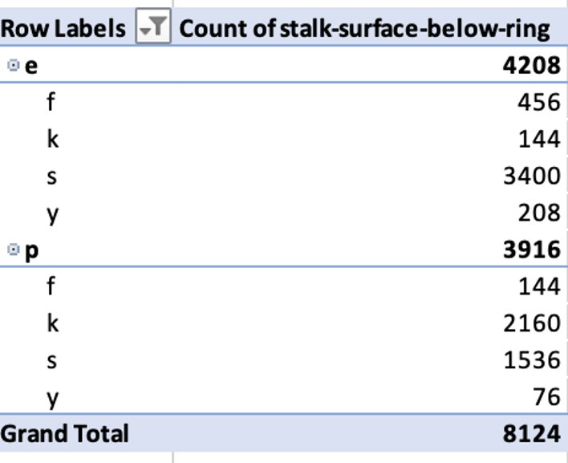
Stalk surface- above & Below

Slide 16
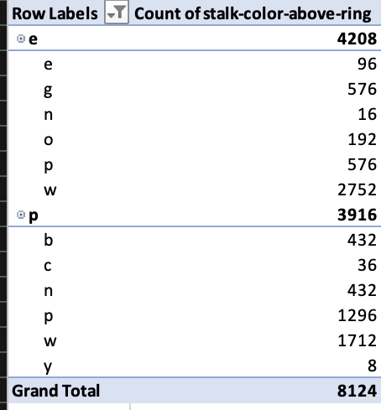
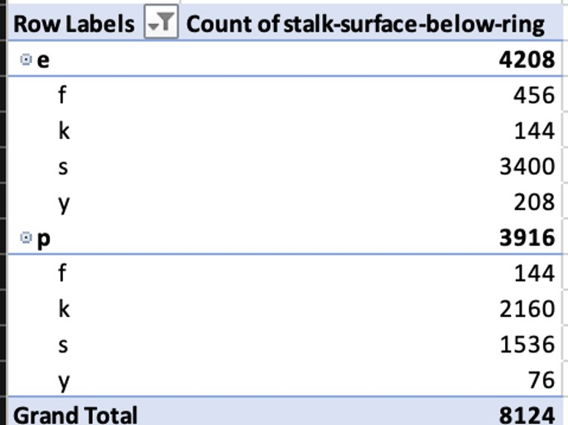
Stalk color- above & Below

Slide 17
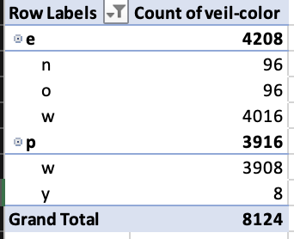
Color of veil

Slide 18
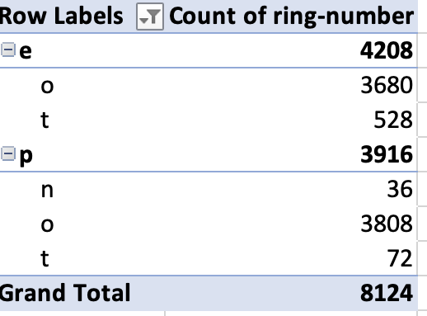
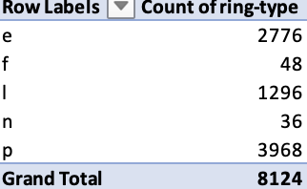
Ring number and Type

Slide 19
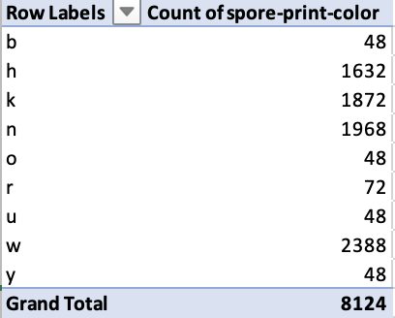
Spore Color

Slide 20
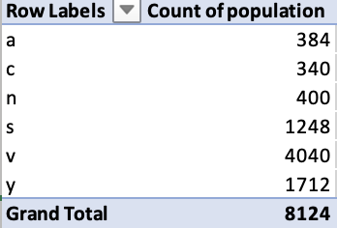
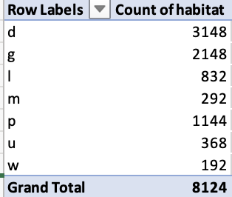
Population and Habitat

Slide 21
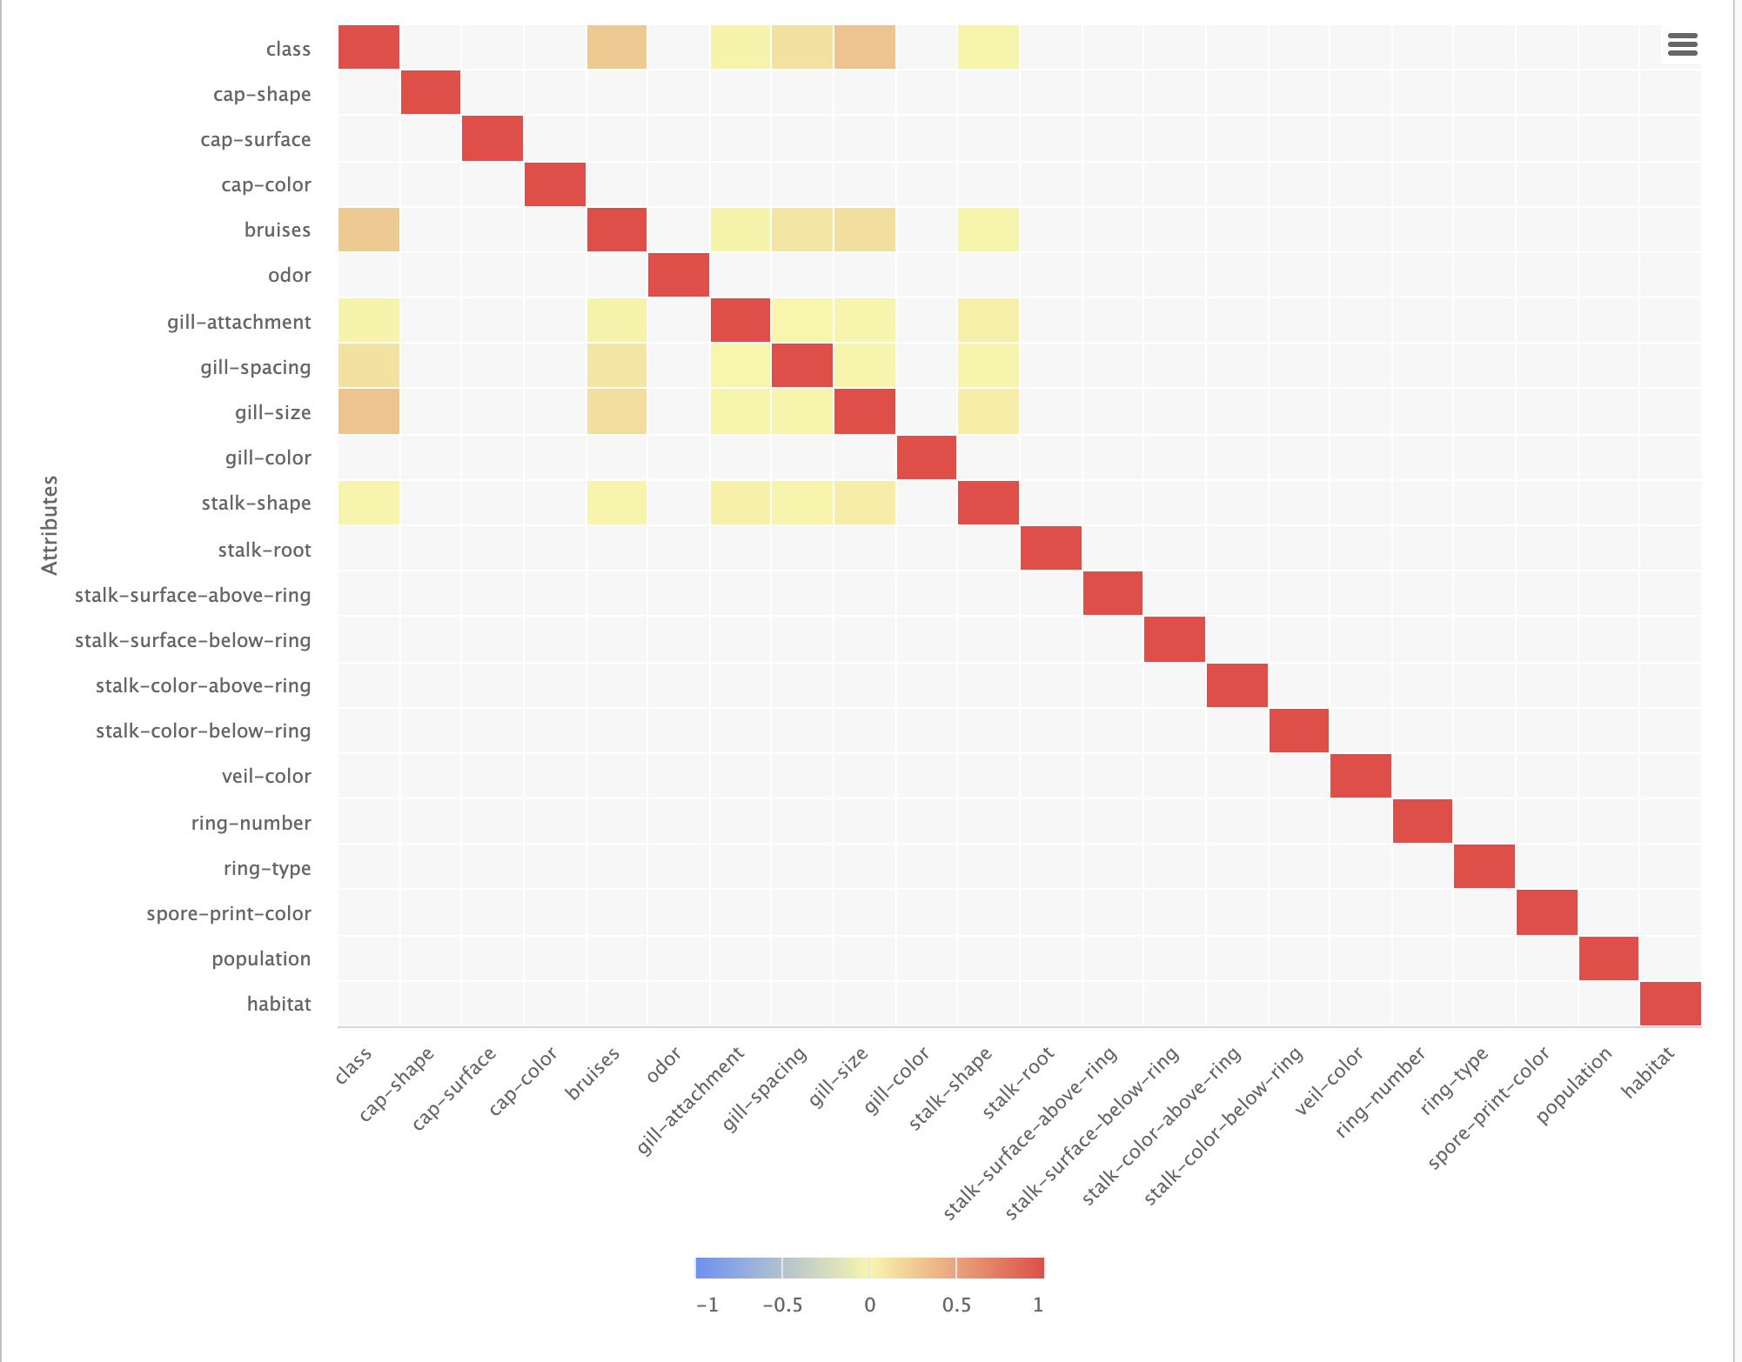
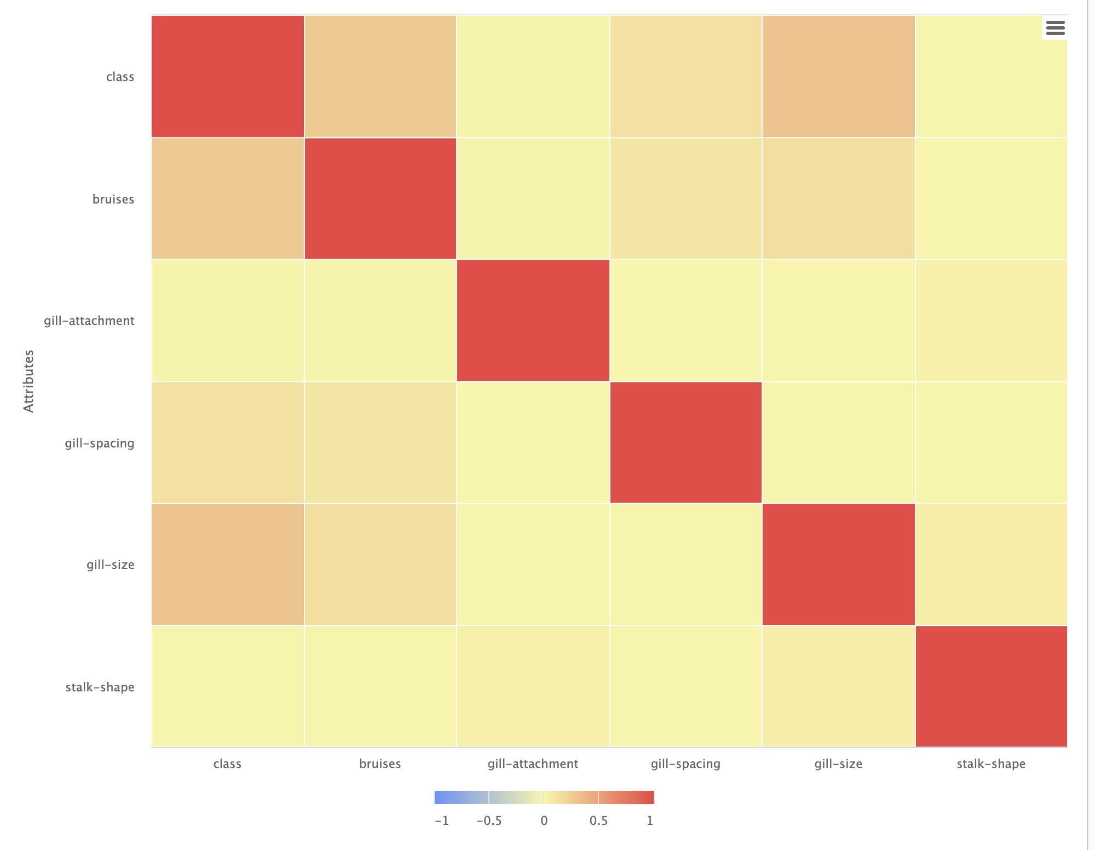
Correlation Matrix
All Attributes in the Dataset

Slide 22
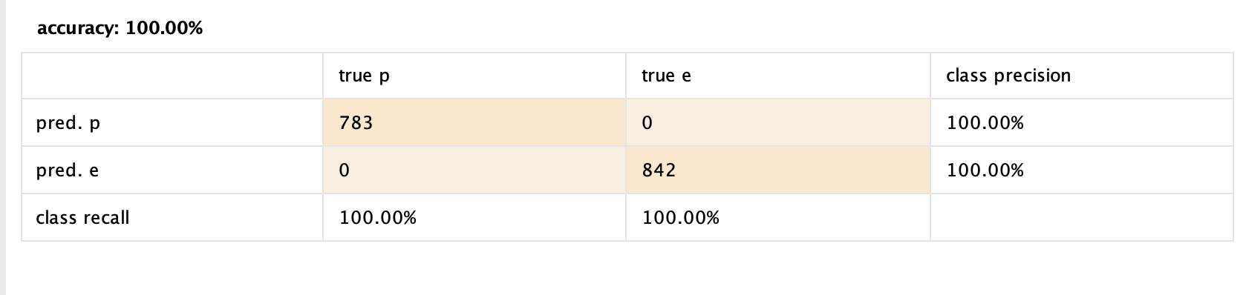
KKN

Slide 23
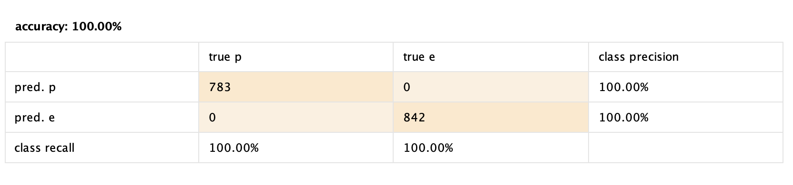
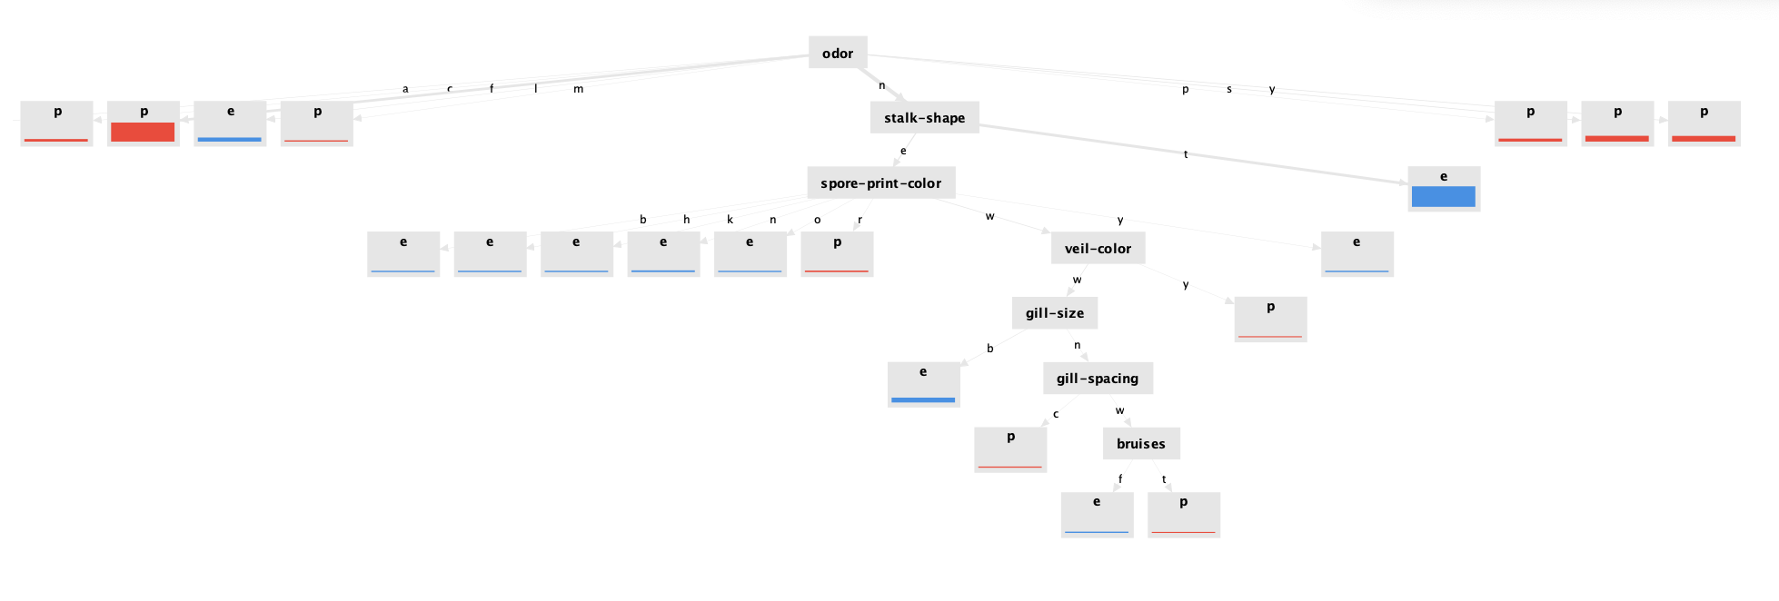
Decision Tree

Slide 24
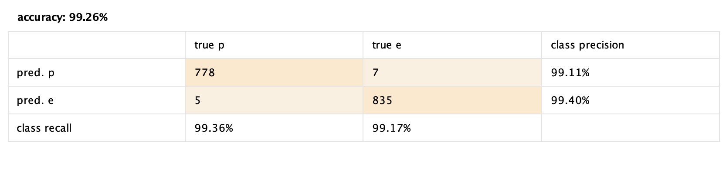
Naïve Bayes

Slide 25
Results
K-NN and Decision Trees are the best models for this Data Set
Both models provided 100% accuracy before any optimization
The Naïve Bayes Model was very accurate
Predicted that 5 mushrooms were edible when they were poisonous
The Decision Tree was the best to create “rules-of-thumb” when it comes to mushrooms
If the mushroom smells like Anise, it’s edible
If the mushroom has no smell and a tapering stalk shape it’s edible

Slide 26
Sources
https://www.audubon.org/national-audubon-society-field-guides
https://www.viator.com/blog/Where-to-Go-Mushroom-Foraging-in-the-US/l98113#:~:text=All%20state%20forests%20allow%20harvesting,to%20five%20gallons%20per%20day.
https://emedicine.medscape.com/article/167398-overview#?form=fpf

